Slide 1
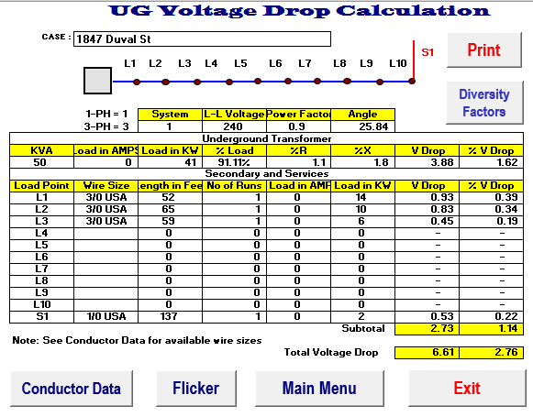
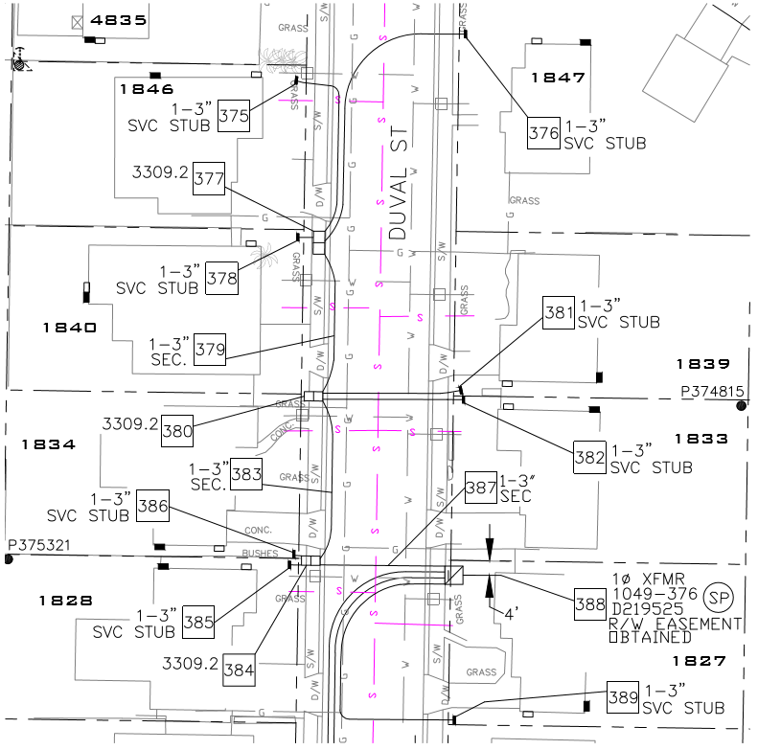
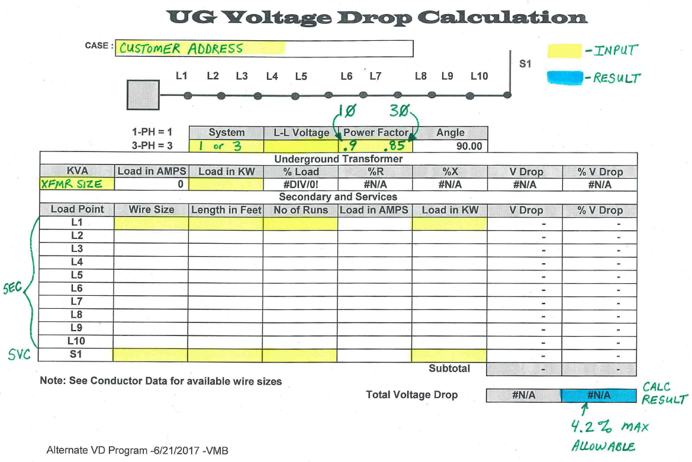
VOLT DROP & FLICKER – ALTERNATE CALCULATOR (1 PH VD UG) – EMAIL TO DESIGN REVIEWER / POC

Slide 2
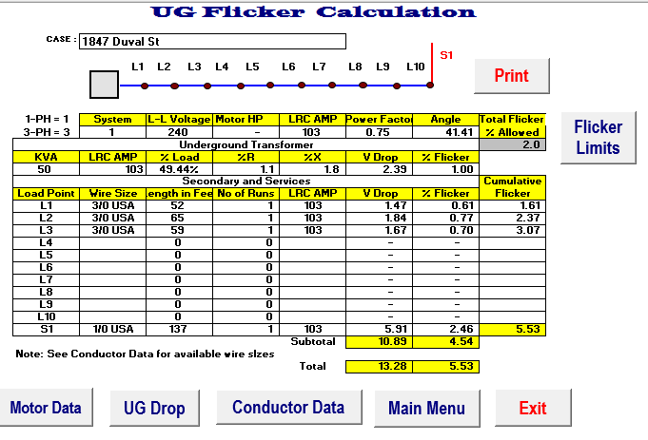
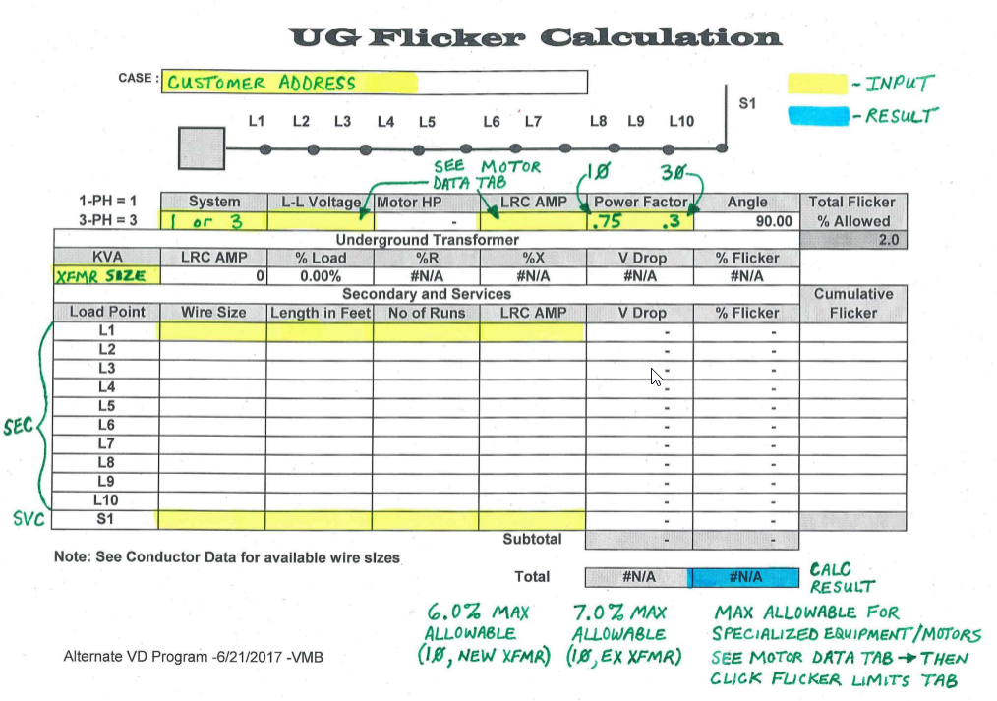
VOLT DROP & FLICKER – ALTERNATE CALCULATOR (1 PH FL UG) – EMAIL TO DESIGN REVIEWER / POC

Slide 3
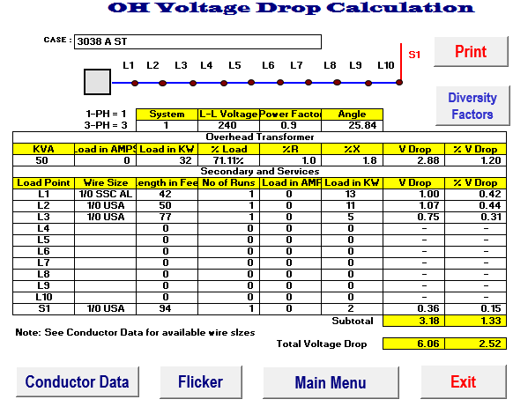
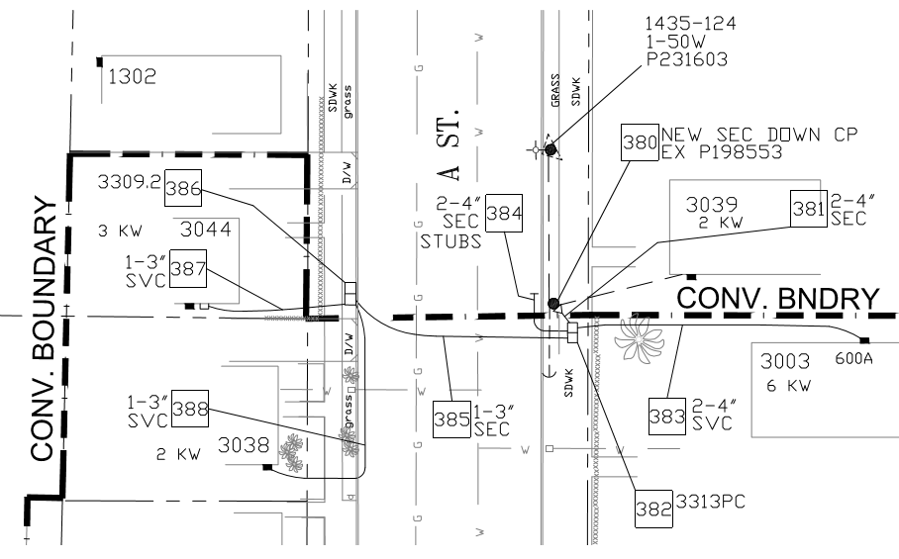
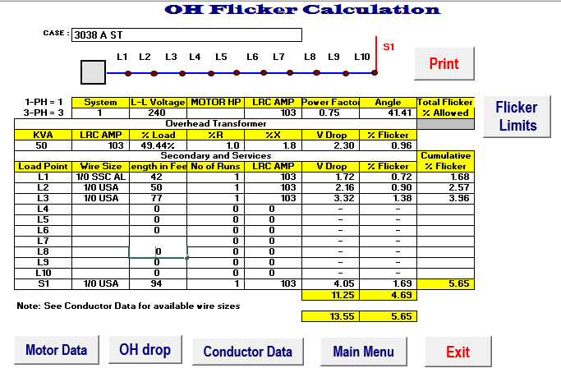
VOLT DROP & FLICKER – ALTERNATE CALCULATOR (1 PH OH TO UG) – EMAIL TO DESIGN REVIEWER / POC

Slide 4
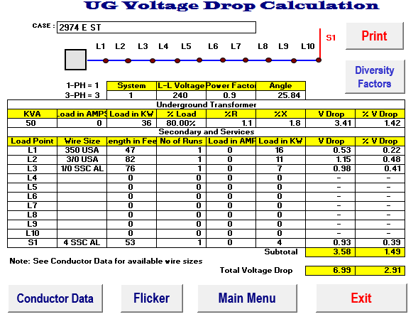
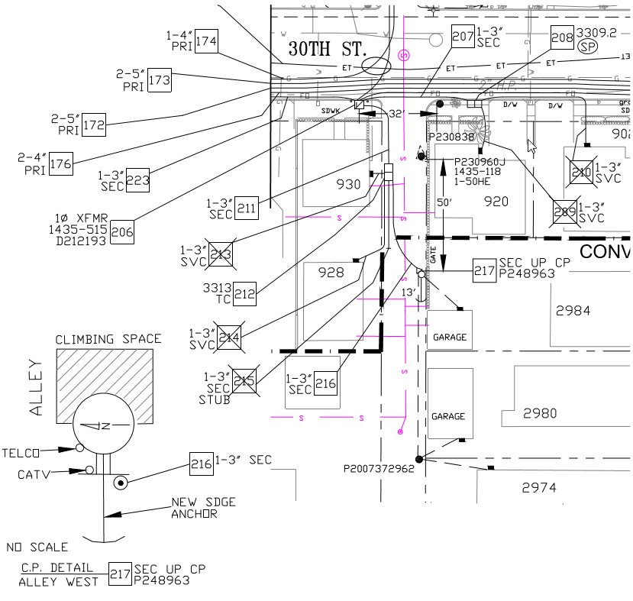
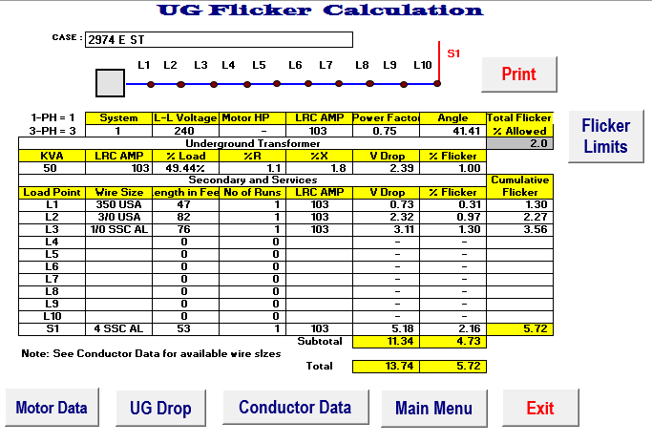
VOLT DROP & FLICKER – ALTERNATE CALCULATOR (1 PH UG TO OH) – EMAIL TO DESIGN REVIEWER / POC

Slide 5
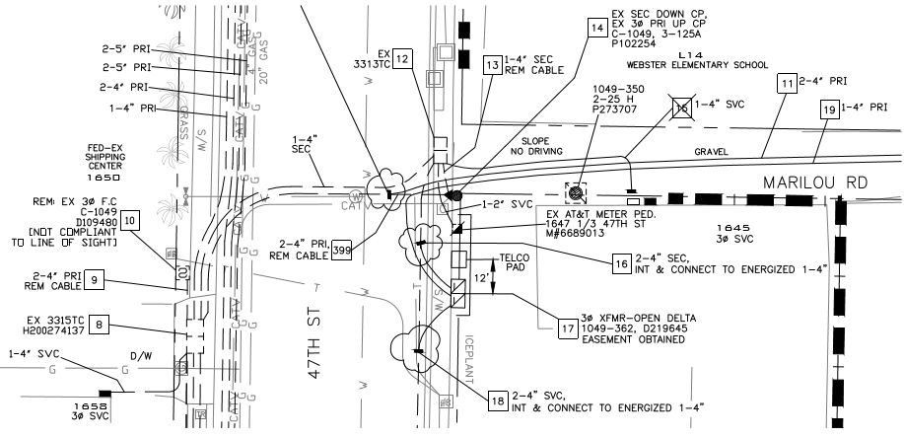
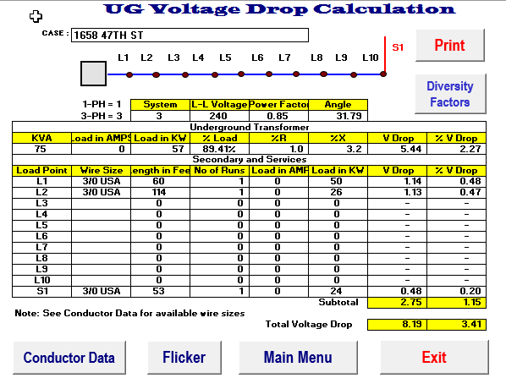
VOLT DROP & FLICKER – ALTERNATE CALCULATOR (3 PH VD) – EMAIL TO DESIGN REVIEWER / POC

Slide 6
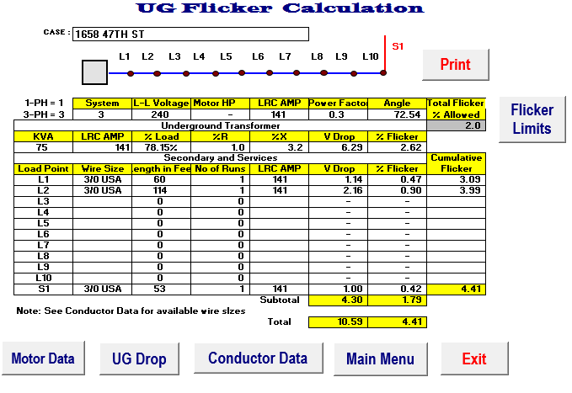
VOLT DROP & FLICKER – ALTERNATE CALCULATOR (3 PH VD) – EMAIL TO DESIGN REVIEWER / POC

